Slide 1

Digital Portfolio
STUDENT NAME SHEYAMALA.K
REGISTER NO AND NMID: 2422k0742 & asbruaj2422D742
DEPARTMENT: School of Computer Science
COLLEGE: AVP Collage of Arts and Science

Slide 2
PROJECT TîTLE
Digital Portfolio

Slide 3

AGEND
Problem Statement
ProjectOverview
End Users
Tools and Technologies
Portfolio design and Layout
Features and Functionality
Results and Screenshots
Conclusion
GitHub Link

Slide 4




PROBLEM STATEMEN
Without a structured digital portfolio
system:
Students struggle to demonstrate their competences beyond grades and certificates.
Teachers and mentors lack a centralized tool to evaluate student progress over time.

Slide 5

PROJECT
OVERVIEW
The Student Digital Portfolio is a Dynamic platform that empowers learners to showcase their academic achievements, skills and personal growth in an interactive and professionals way, bridging the gap between traditional records and modern digital presentation

Slide 6



WHOARE THE END USERS?
Designed for sludents
showcase growth, educators
track progress and parents Witness
achievements II i seamless platform.

Slide 7



TOOLS AND TECHNIQUES
HTML&CSS:
For structure and styling
JavaScript
For interactivity
CodePen
For development and testing
GitHub:
For version control and project
hosting
■

Slide 8

POTFOLIO DESIGN AND LAYOUT
Responsive design with CSS €exbox
Dark theme color palette
Clean navigation bar with logo
Section - based layout (About, Skills, Projects,
Education, Achievements, Contact

Slide 9

FEATURES AND FUNCTIONALIW
Dynamic footer year update with
JavaScript
Smooth navigation with anchor links
Theme toggle button for dark/light mode
Highlighted text for key terms (e.g., IoT,
AI/ML)

Slide 10

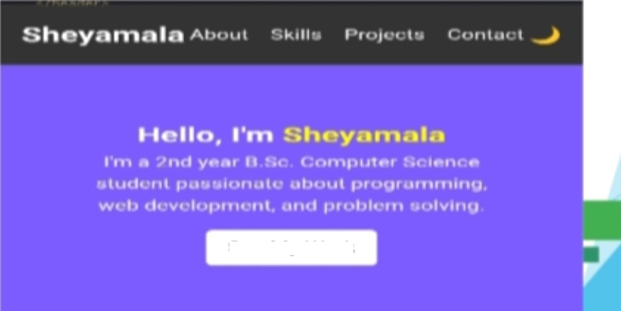
RESULTS AND SCREENSHOTS
Developed a responsive and interactive portfolio website with clear sections, smooth navigations and a professionals design supported by screenshot

Slide 11



CONCLUSION
This portfolio highlights my growth, skills and creativig as a learner. It rejects my progess so far and my commitment to keep learning, improving and taking on new challenges in the future.

